Slide 1
Open and Reproducible Science Using Python and GitHub
Adam Thomas & John Lee
Data Science and Sharing Team, FMRIF, NIMH

Slide 2
Outline
Why do we need Open Science?
What is Open Science?
How do I do Open Science?

Slide 3
Outline
Why do we need Open Science?
What is Open Science?
How do I do Open Science?

Slide 4
Outline
What Problems are we trying to solve?
What is Open Science?
How do I do Open Science?

Slide 5
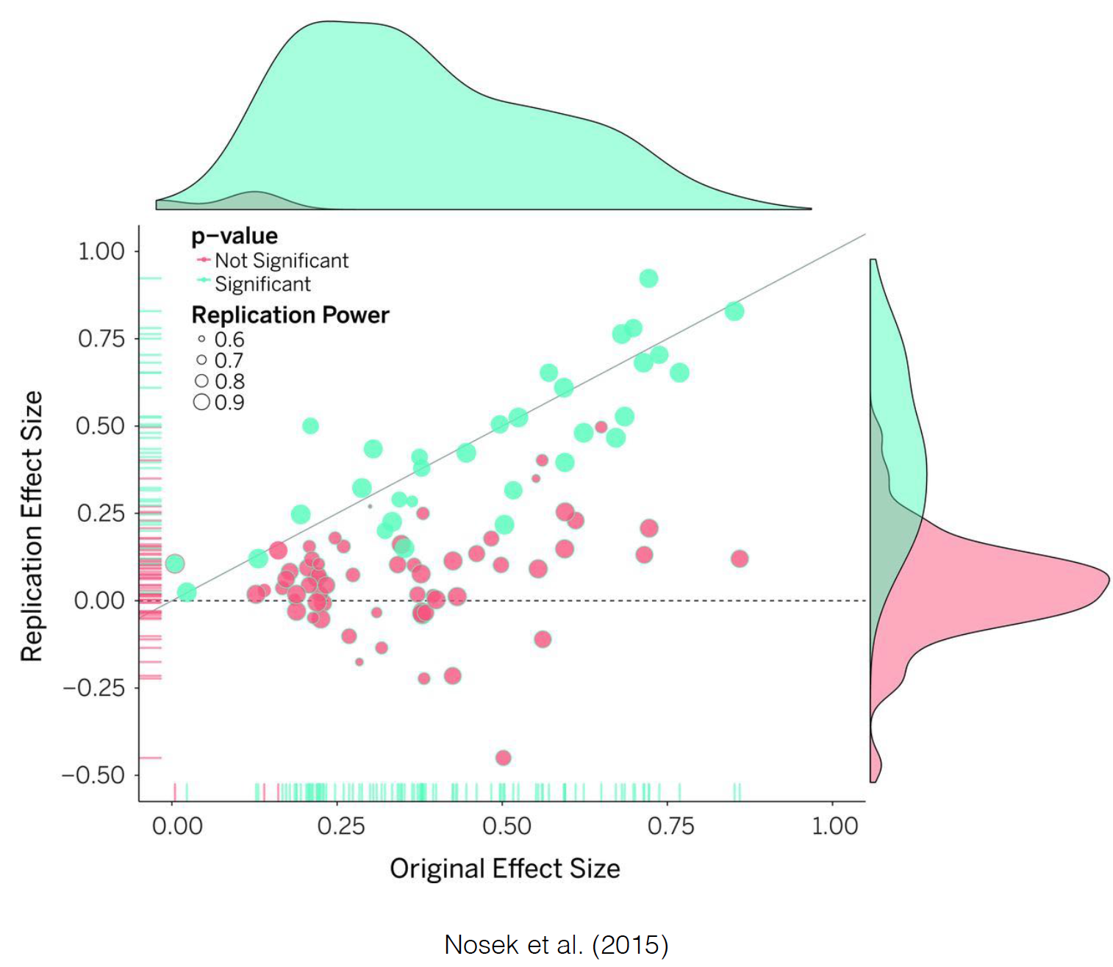
Problem: Reproducibility
OPEN SCIENCE: WHY ➔ WHAT ➔ HOW

Slide 6
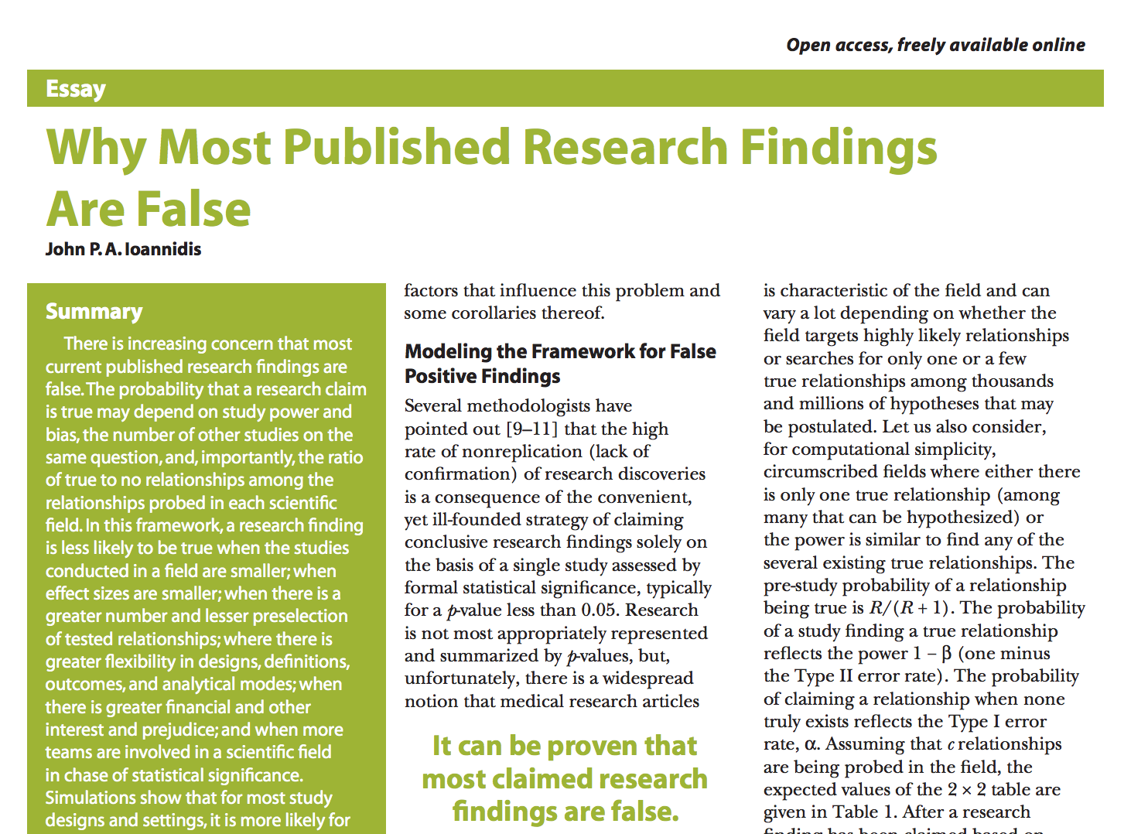

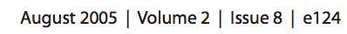
The Problem: Reproducibility
OPEN SCIENCE: WHY ➔ WHAT ➔ HOW

Slide 7
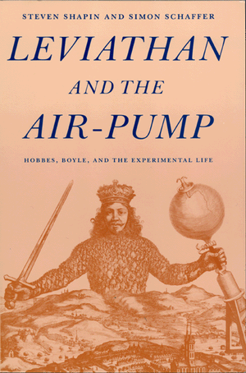
Why: Replicable vs. Reproducible
Replication is the foundation of science
“By repeating the same experiment over and over again, the certainty of fact will emerge.” – Robert Boyle

Slide 8
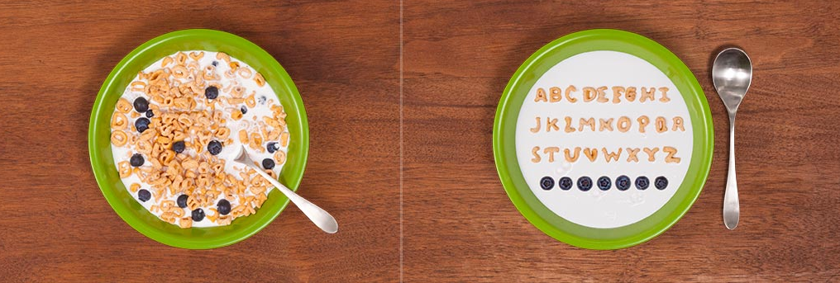
Problem: Wasted time & resources
“How much time do you spend handling, reorganizing, and managing your data as opposed to actually doing science?”
Median answer is 80%
OPEN SCIENCE: WHY ➔ WHAT ➔ HOW

Slide 9

Problem: Wasted Time & resources
Unpublished Data
File drawer problem
Lost staff & lost metadata
Underutilized data
OPEN SCIENCE: WHY ➔ WHAT ➔ HOW

Slide 10
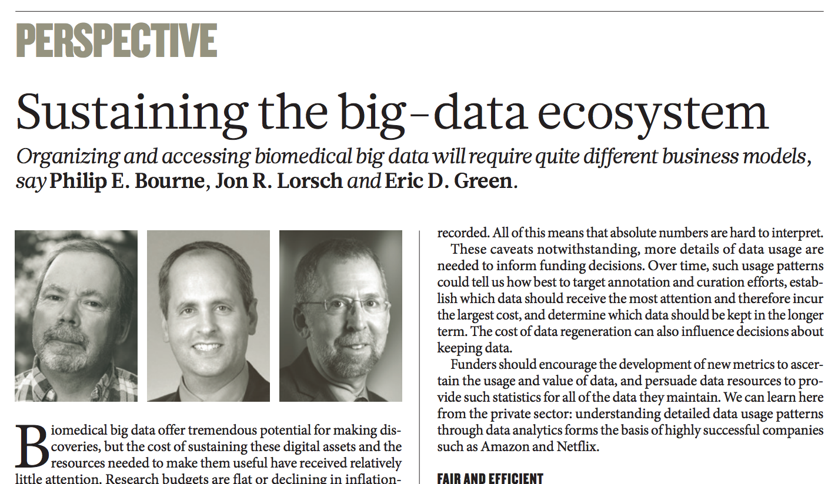
Problems: The big-data revolution
OPEN SCIENCE: WHY ➔ WHAT ➔ HOW

Slide 11
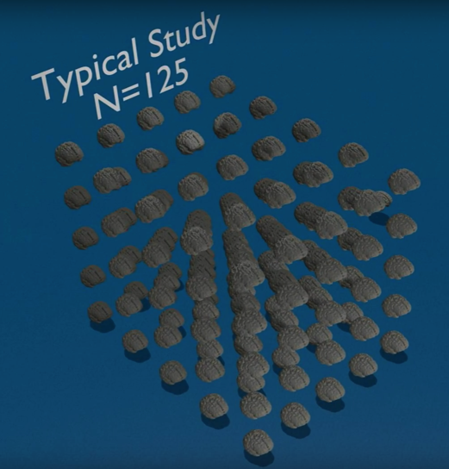
Problems: The big-data revolution
UK Biobank Imaging
Initiative
OPEN SCIENCE: WHY ➔ WHAT ➔ HOW

Slide 12
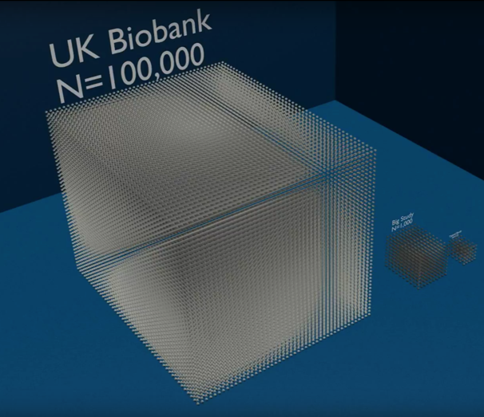
Problems: The big-data revolution
UK Biobank Imaging
Initiative
OPEN SCIENCE: WHY ➔ WHAT ➔ HOW

Slide 13
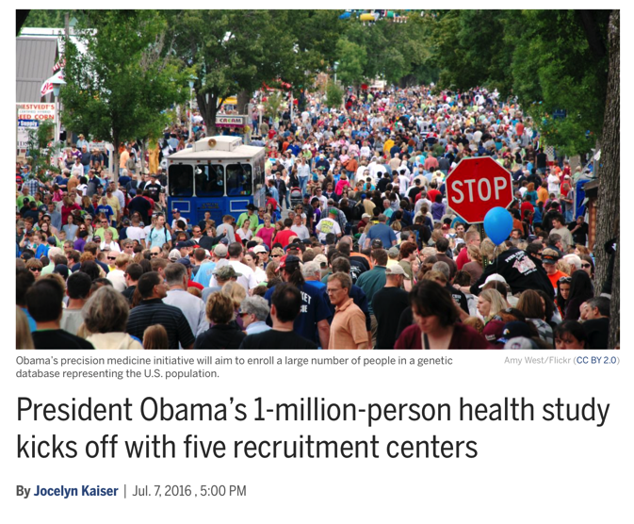
Problems: The big-data revolution
OPEN SCIENCE: WHY ➔ WHAT ➔ HOW

Slide 14
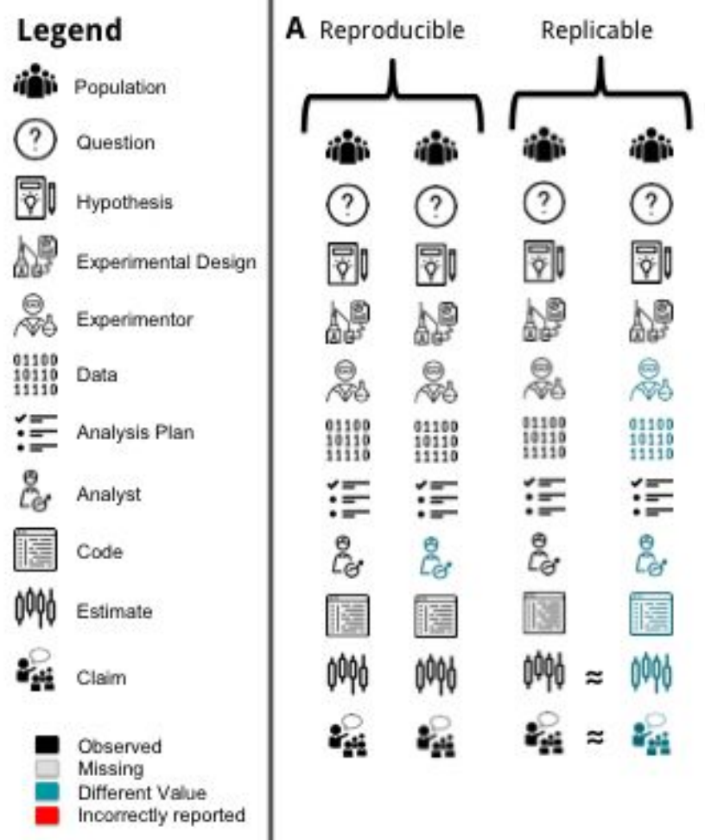
Why: Replicable vs. Reproducible
Replication: new data, different team
Reproducible: Same data, different team
Where replication is hard or impossible, reproducible is the next best thing
http://biorxiv.org/content/biorxiv/early/2016/07/29/066803.full.pdf

Slide 15
Outline
The Problem
Reproducibility
Wasted resources
Lack of integration
Ill-prepared to work with big datasets
What is Open Science?
How do I do Open Science?

Slide 16
Outline
Why do we need Open Science?
What is Open Science?
How do I do Open Science?

Slide 17
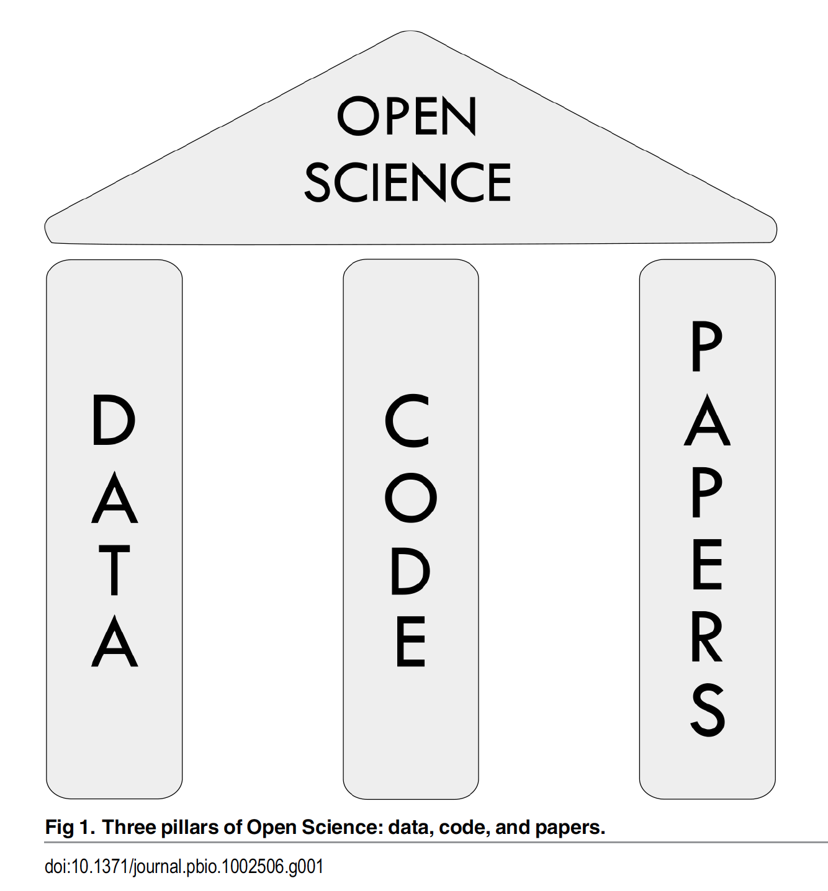
What is Open Science?
OPEN SCIENCE: WHY ➔ WHAT ➔ HOW

Slide 18
What is Open Data?
Data deposited in a public, community-recognized repository with a stable DOI
Follows FAIR Principle
Findable
Accessible
Intra-operable
Reusable
Should be deposited before publication
OPEN SCIENCE: WHY ➔ WHAT ➔ HOW

Slide 19
Open Data: Community recognized Repositories
Domain Specific Repos
OpenfMRI
dbGap
FCP/INDI
LONI
NITRC
XNAT Central
Data Agnostic Repos
FigShare
Dryad
DataVerse
Open Science Framework
NIMH Data Archive (NDAR)
OPEN SCIENCE: WHY ➔ WHAT ➔ HOW

Slide 20
What is Open Code?
Open code enables greater reproducibility
(includes non-code methods)
OPEN SCIENCE: WHY ➔ WHAT ➔ HOW

Slide 21
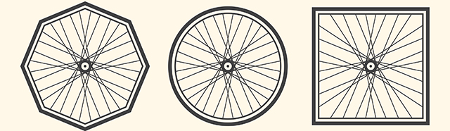
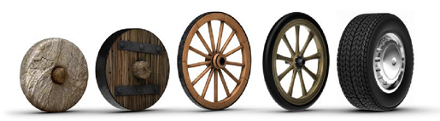
Open Code – Don’t Reinvent
Reuse and improve
OPEN SCIENCE: WHY ➔ WHAT ➔ HOW

Slide 22



Open Code - Version Control
Version control systems allows you to:
Store all of your analysis in a central repository
Keep a history of “snapshots” of your evolving analysis
Quickly switch between different versions of your analysis
Adopt and modify code from other scientists
Collaborate
OPEN SCIENCE: WHY ➔ WHAT ➔ HOW

Slide 23
Why: Replicable vs. Reproducible
Replication: new data, different team
Reproducible: Same data, different team
Where replication is hard or impossible, reproducible is the next best thing
http://biorxiv.org/content/biorxiv/early/2016/07/29/066803.full.pdf

Slide 24
This Course: Learning Git
Sticky Notes
Philosophy: minimize lecturing, mostly interactive and live
Ask and help your neighbors
Google Docs for sharing code snippets and links:
http://bit.ly/NIHPIDAY2017

Slide 25
What are Open Papers?
Preprint posting
Open access
Open review
OPEN SCIENCE: WHY ➔ WHAT ➔ HOW

Slide 26
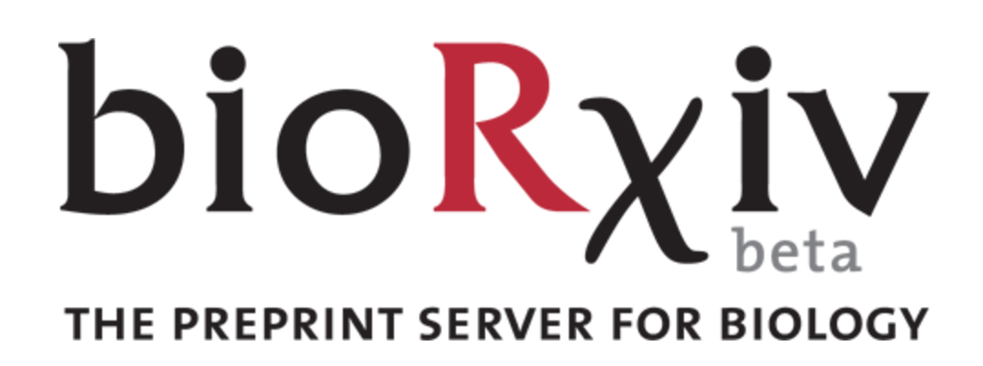

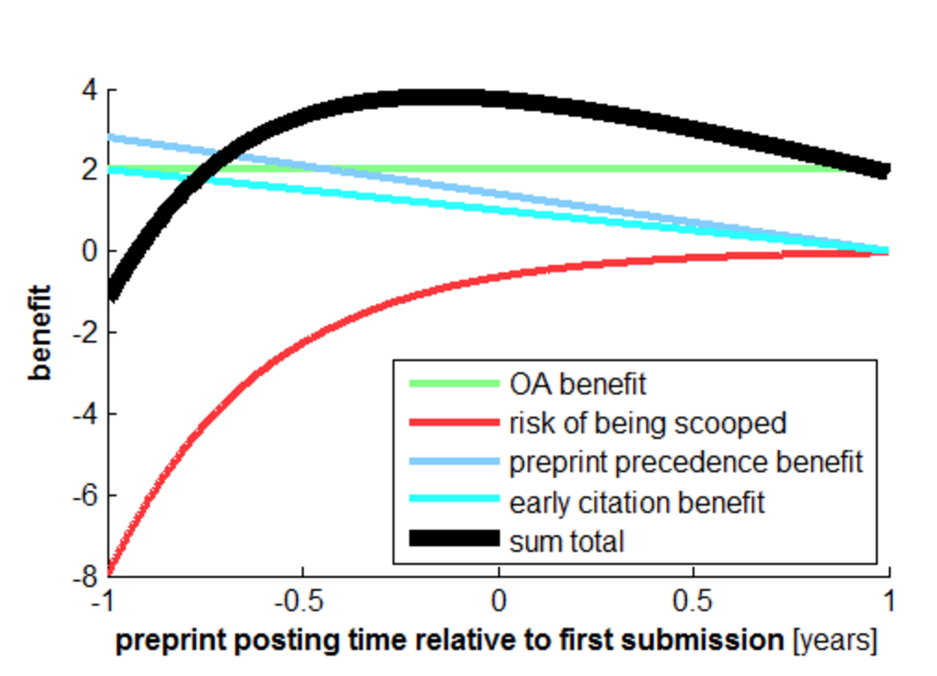
Open Papers: Preprint posting
Benefits:
Open access
Catch errors
Earlier citation
Earlier precedence, prevent scooping
Speed and improve final submission
Kriegeskorte (2016) DOI:10.15200/winn.145838.88372
OPEN SCIENCE: WHY ➔ WHAT ➔ HOW

Slide 27
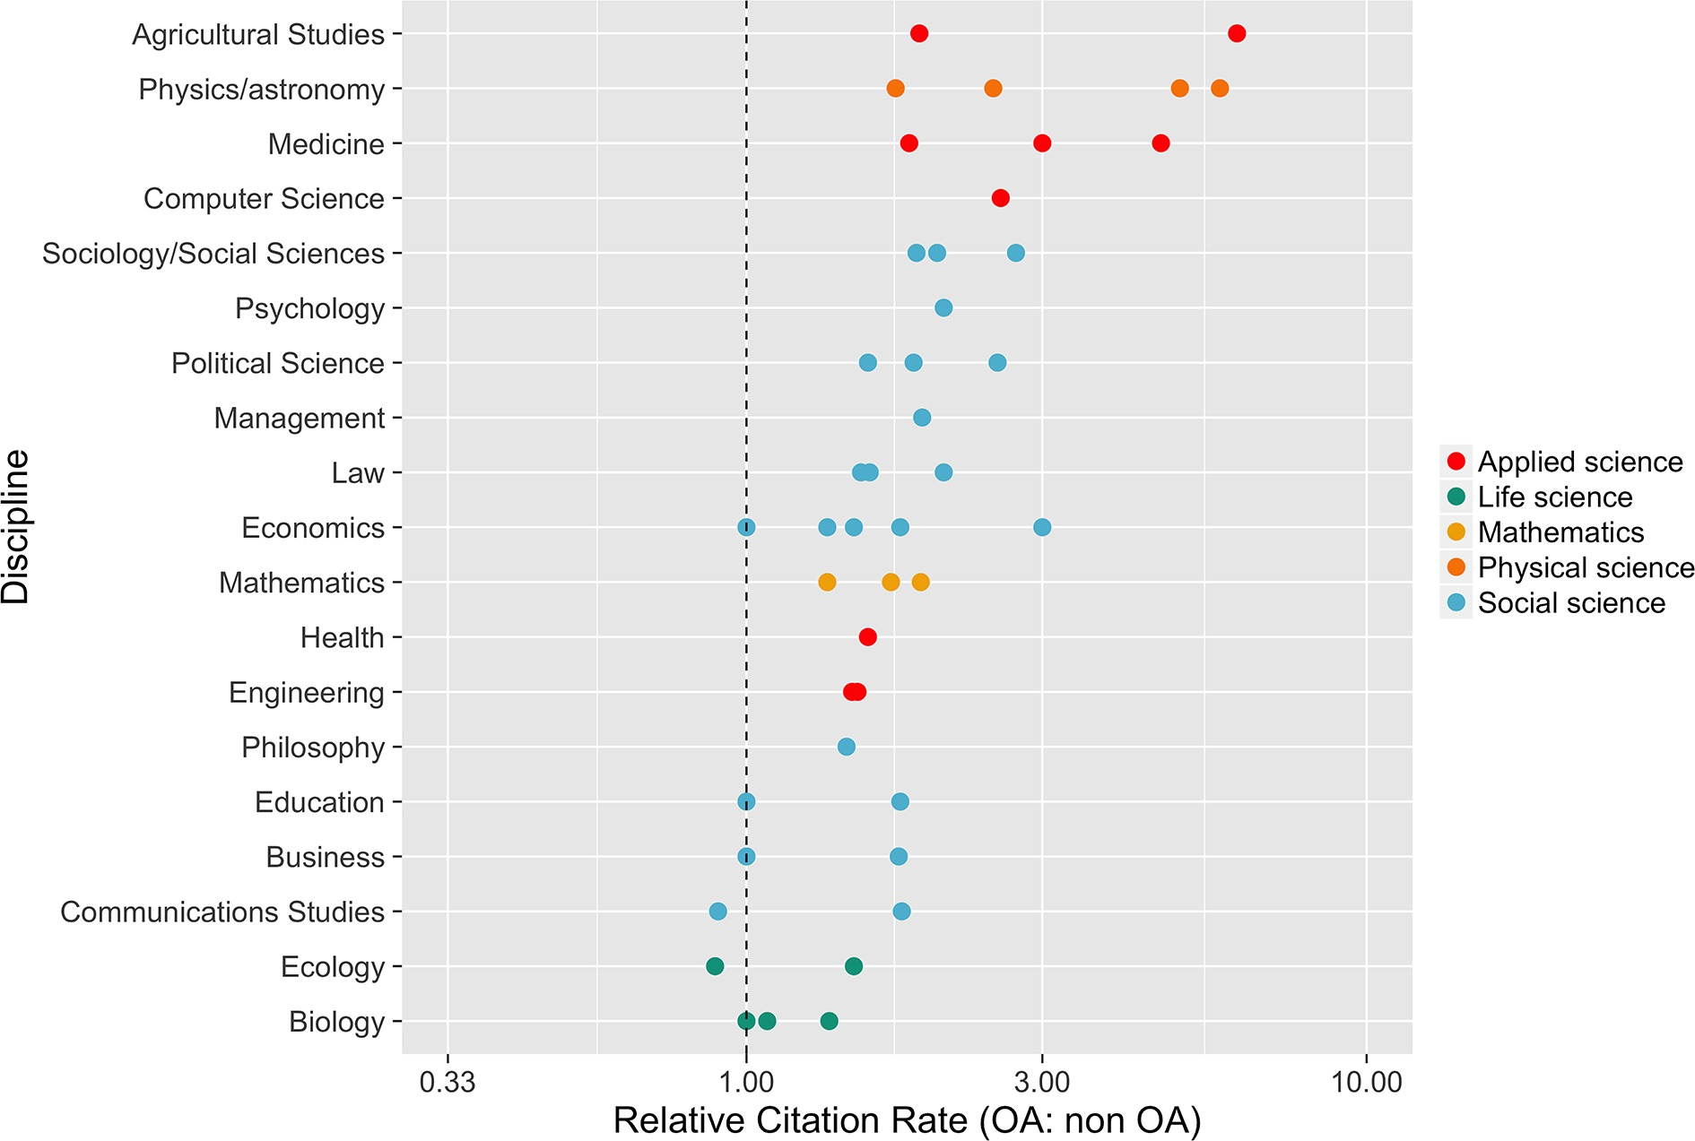
Open Access Open access publication are cited more
https://elifesciences.org/content/5/e16800%20
mean citation rate of OA articles divided by mean citation rate of non-OA articles
OPEN SCIENCE: WHY ➔ WHAT ➔ HOW

Slide 28
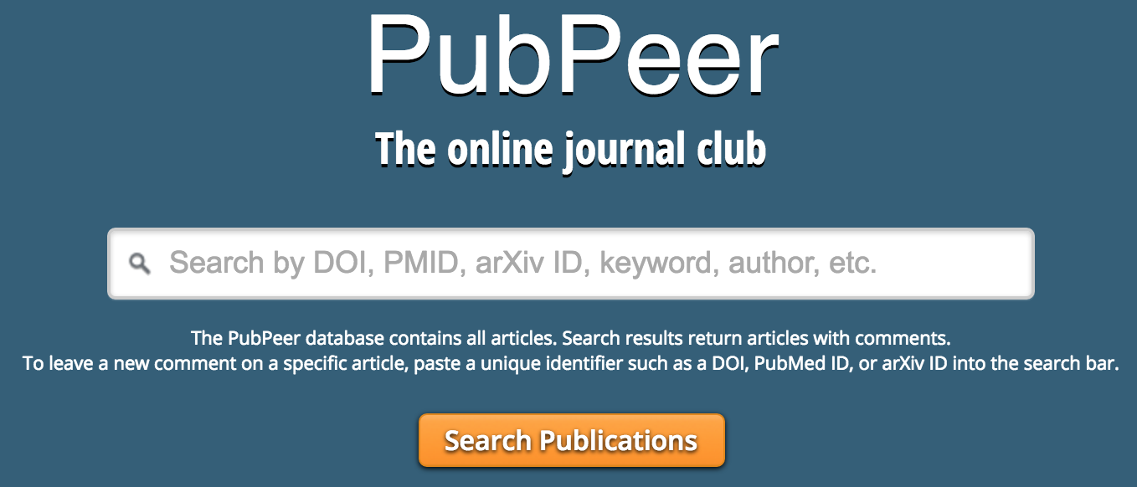

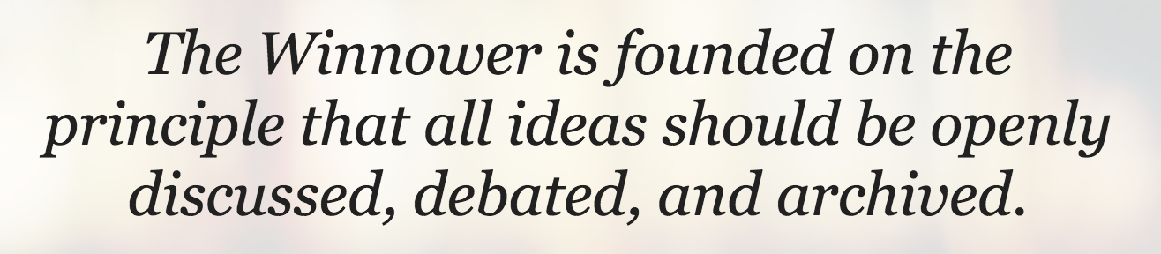
Open Review
Public discussion of pros and cons of submission
Optional anonymity
Prevent low-quality and or biased review
OPEN SCIENCE: WHY ➔ WHAT ➔ HOW

Slide 29
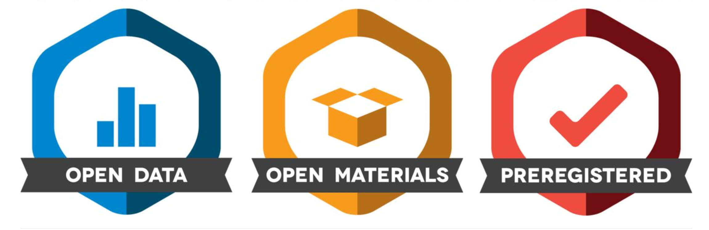
Incentives: Badges
OPEN SCIENCE: WHY ➔ WHAT ➔ HOW

Slide 30
Outline
Why do we need Open Science?
What is Open Science?
How do I do Open Science?
OPEN SCIENCE: WHY ➔ WHAT ➔ HOW

Slide 31
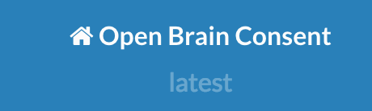
How – Plan Ahead
Get data sharing in your protocol:
NIMH Data Sharing Commitee
https://open-brain-consent.readthedocs.io
When designing, collecting, and analyzing consult with standards documents:
Enhancing Quality and Transparency of Health Research (EQUATOR) http://www.equator-network.org
OPEN SCIENCE: WHY ➔ WHAT ➔ HOW

Slide 32
Standards – EQUATOR & COBIDAS
EQUATOR: Different standards for different designs
RCT, crossover, observational, etc.
COBIDAS: Recommendation for brain imaging
Both EQUATOR and COBIDAS focus on reporting,
Reviewing them in advance will help you plan and design your study
Also useful reference when reviewing papers
OPEN SCIENCE: WHY ➔ WHAT ➔ HOW

Slide 33
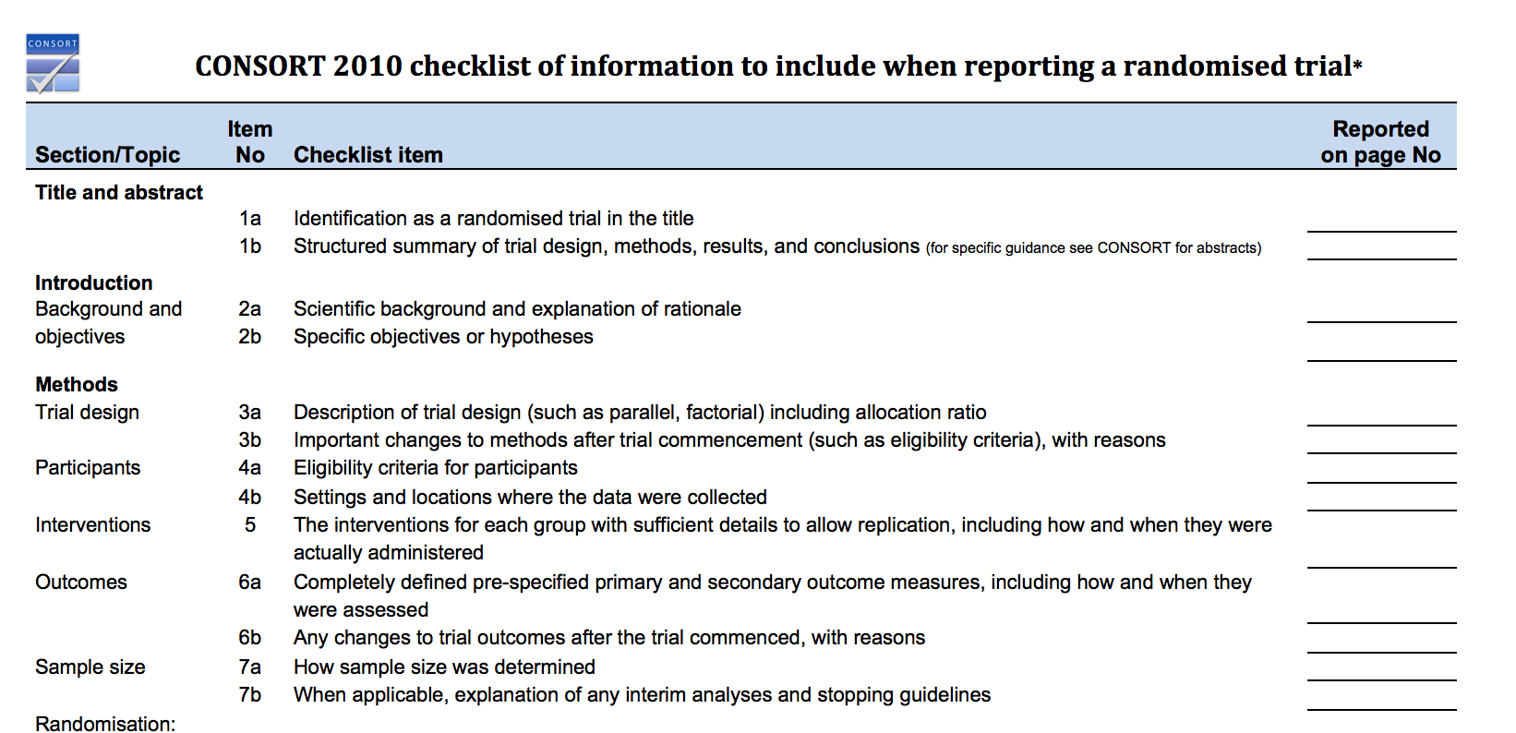
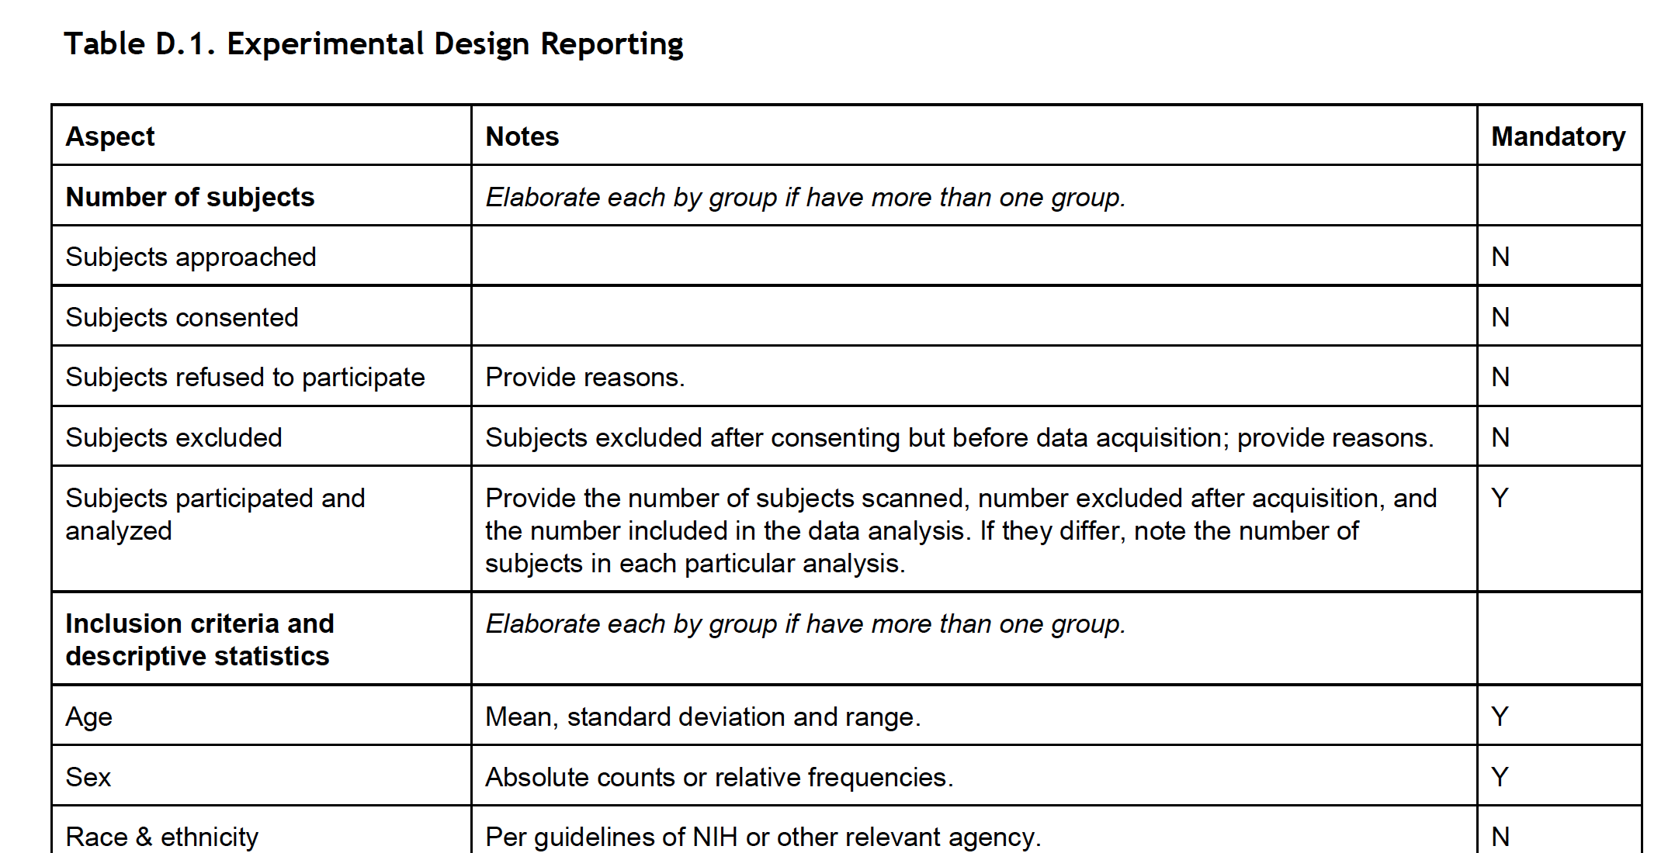
Standards – EQUATOR
Checklists
OPEN SCIENCE: WHY ➔ WHAT ➔ HOW

Slide 34
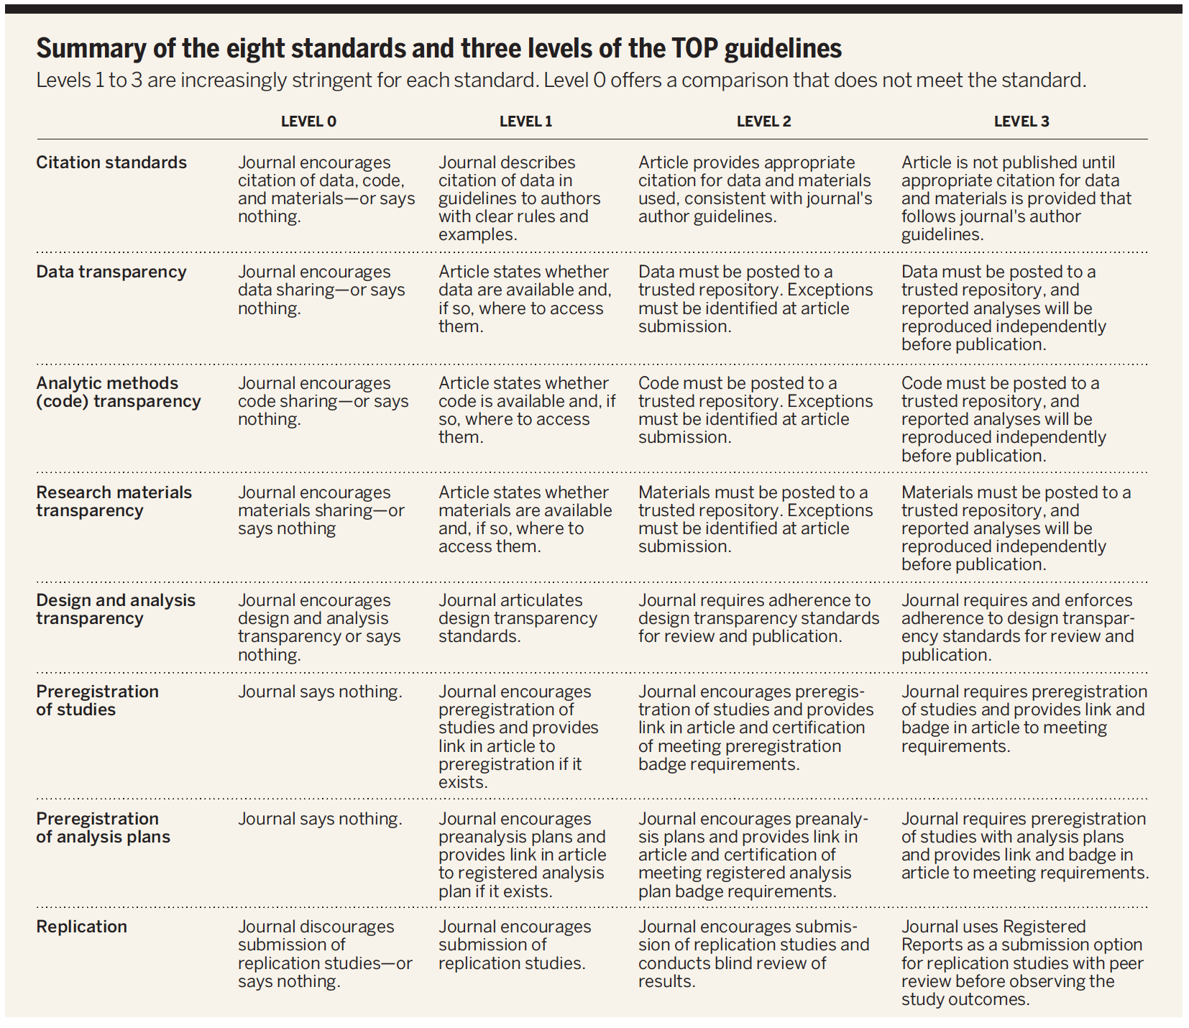
How to be Open – Choose your battles Be open when you can, as you can
OPEN SCIENCE: WHY ➔ WHAT ➔ HOW

Slide 35

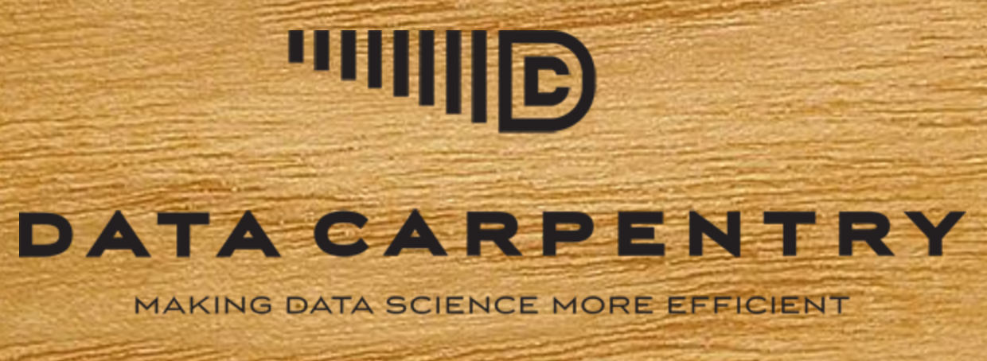
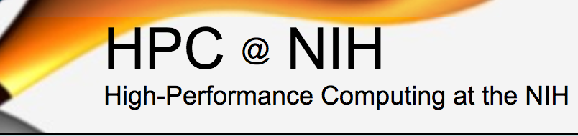


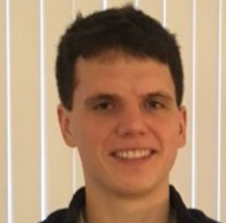

How to Open – You don’t have to do it alone
Training
Asking for help
HPC Walk-in sessions
NIMH Data Science and Sharing Team
Adam Thomas John Lee Dylan Nielson
OPEN SCIENCE: WHY ➔ WHAT ➔ HOW

Slide 36

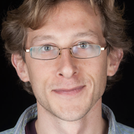

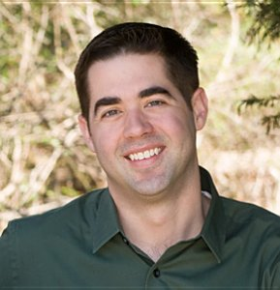
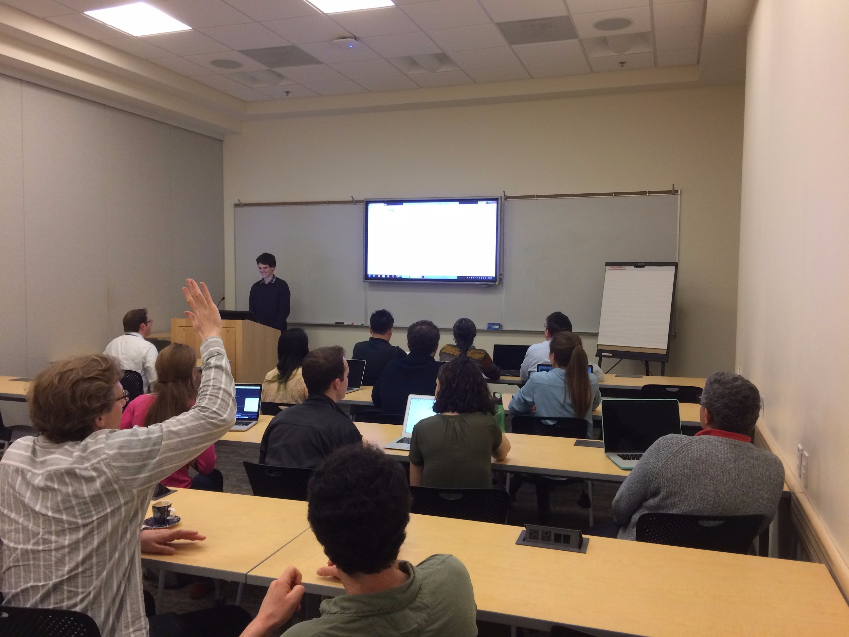
Data Science and Sharing Team’s
Workshop on Open and Reproducible Neuroscience
Mar 13-17th, 2017
45 applications, 25 students attended
16 hours of instruction on Python, Git, Data Repositories, Biowulf integration, Pre-registration, and statistical rigor
Instructors from Gallaudet, King’s College London, AFNI and Biowulf Teams
All course material available online: https://github.com/nih-fmrif/NIMH_repro_2017
Next course Nov 2017

Slide 37
Summary and Take Homes
Science is changing (for the better) in both scope (big) and culture (open) to address future challenges
Open science strives to maximize reproducibility and transparency of data, code, and papers
Adopting Open Science practices yields benefits in productivity, impact, and reach
You don’t have to do it all at once, and you don’t have to do it alone
OPEN SCIENCE: WHY ➔ WHAT ➔ HOW

Slide 38
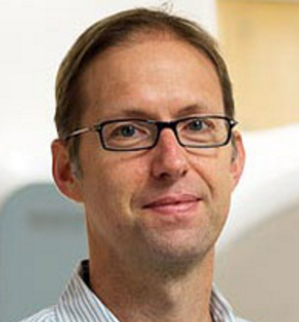

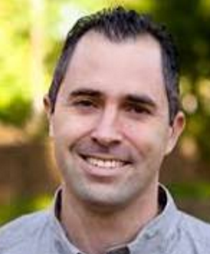
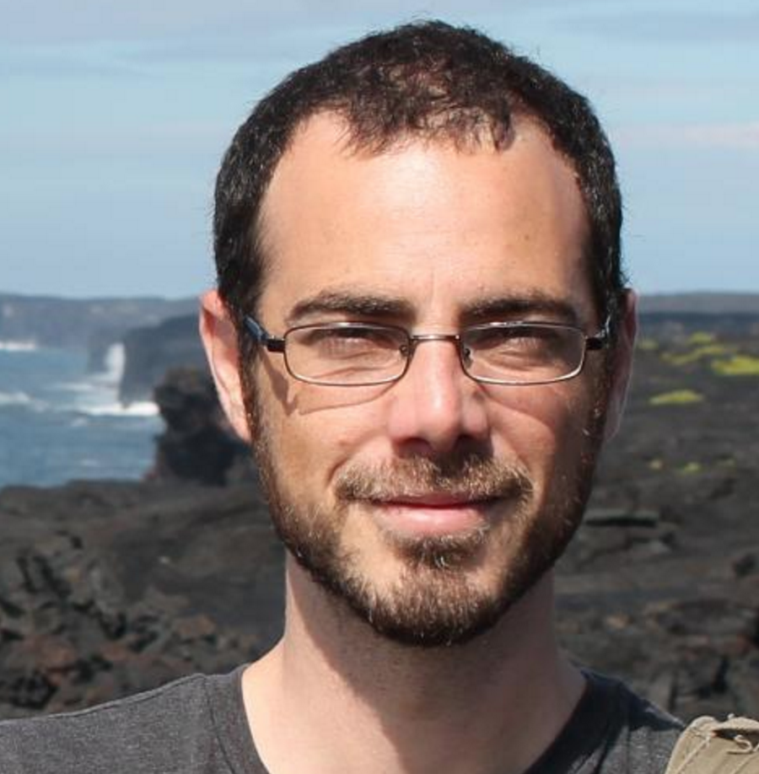
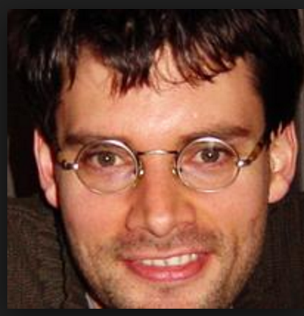
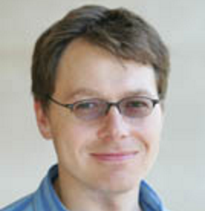

Credits Material borrowed, adapted, and/or stolen from:
Russ Poldrack
Chris Gorgolewski
Brian Nosek
Tal Yorkoni
Niko Kriegeskorte
Tom Nichols
Phil Bourne

Slide 39
Thanks! See online slides for more URLs and references: https://github.com/agt24 Questions?

